Slide 1
ICE-Score: Instructing Large Language Models to Evaluate Code
Presentation By:
Ayyad asif (21L-7561), Fahad Iqbal (21L-5188), Sheraz ahmad (21l-5394), Hammad Tufail (21l-5412)

Slide 2
Introduction
- LLMs have improved Natural Language Generation (NLG) quality.
- Traditional metrics (BLEU, ROUGE) fail at semantic evaluation.
- Code generation requires evaluation of syntax and functionality.
- Test-based evaluation is resource-intensive and brittle.

Slide 3
Problem Statement
- BLEU and ROUGE have low correlation with human judgment in code tasks.
- High-quality reference code is often unavailable.
- Human-written test suites are expensive and require sandboxing.
- Need for a reference-free, human-aligned evaluation metric.

Slide 4
Proposed Solution – ICE-Score
- ICE = Instructing Code Evaluation.
- LLM-based metric for evaluating generated code without references.
- Evaluates based on Usefulness and Functional Correctness.
- Removes dependency on gold-standard outputs and test suites.

Slide 5
ICE-Score Mechanism
- LLM prompted with problem + generated code snippet.
- Outputs a Usefulness Score and Correctness Score.
- Classifies outputs as Totally Useless, Nearly Useless, etc.
- Scores converted to numerical values for evaluation.

Slide 6
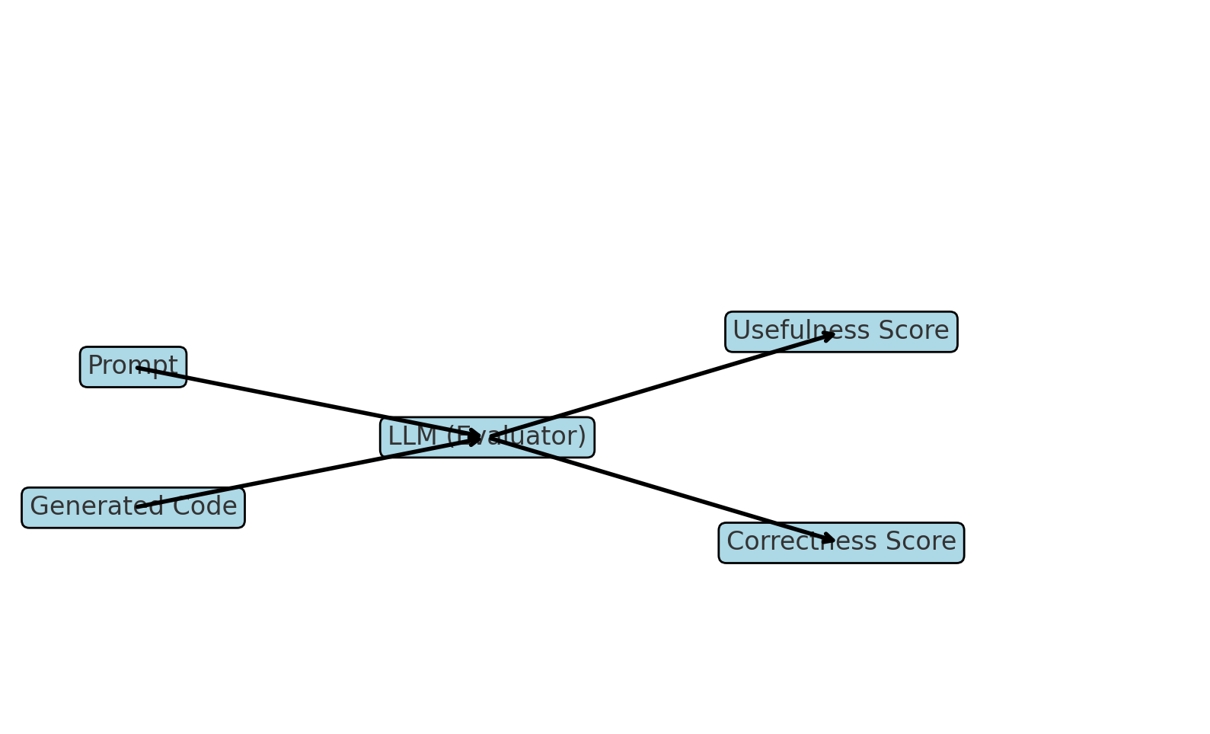
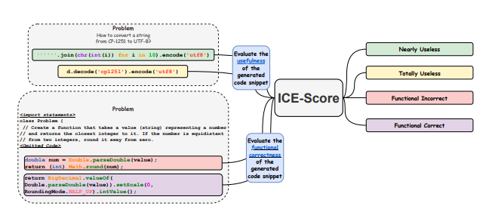
ICE-Score Mechanism – Visual Diagram

Slide 7
Baseline Metrics for Comparison
- BLEU, ROUGE, chrF: rely on lexical overlap.
- CodeBERTScore: learned similarity with references.
- Execution Accuracy: requires test cases and code execution.

Slide 8
Advantages of ICE-Score
- Reference-free and test-free evaluation.
- High correlation with human preferences.
- Effective across multiple programming languages.
- More reliable than traditional metrics.

Slide 9
Methodology
- Use standardized prompts for GPT-3.5/4.
- Rate generated code snippets on usefulness and correctness.
- Evaluate against human-labeled datasets and functional tests.
- Use statistical correlations for comparison.

Slide 10
Mathematical Evaluation
- Correlation metrics used:
- - Spearman’s ρ (rank correlation)
- - Pearson’s r (linear correlation)
- - Kendall’s τ (ordinal association)
- Pearson’s r formula:
- r = Σ((xi - x̄)(yi - ȳ)) / sqrt(Σ(xi - x̄)² * Σ(yi - ȳ)²)

Slide 11
Results – Correlation with Correctness
- ICE-Score outperforms BLEU, ROUGE, CodeBERTScore in all cases.
- Highest correlation with Execution Accuracy.
- Consistent across Python, Java, C++, JavaScript.
- Best alignment with human evaluation.

Slide 12
Ablation Study
- Tested usefulness-only and correctness-only prompts.
- Combined scoring yields best correlation with human judgment.
- Balanced evaluation of semantics and functionality.

Slide 13
Case Study Example
- Task: Round string-number to nearest integer.
- Various outputs rated by ICE-Score.
- Demonstrates strength in semantically correct, non-identical outputs.
- Validates ICE-Score's flexible and robust evaluation.

Slide 14
Limitations
- Dependent on LLM prompt quality.
- Potential LLM hallucinations or biases.
- Requires access to high-performance LLMs (e.g., GPT-4).

Slide 15
Conclusion & Future Work
- ICE-Score is a scalable, human-aligned metric.
- Eliminates need for costly references or test cases.
- Future work includes:
- - Expanding language and task coverage
- - Enhancing prompt robustness
- - Integrating with static analysis tools

